Slide 1
Lesson 7
E115 – Programming and Data analysis

Slide 2
Lesson objectives
At the end of the lesson, you should be able to:
Use a series of debugging tools as follows to fix the errors in your macro
Step Into
Toggle Breakpoint
Immediate Window
Debug.Print
Comment

Slide 3
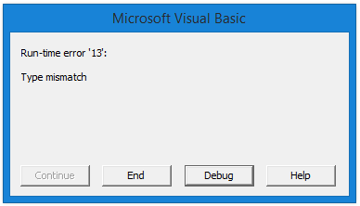
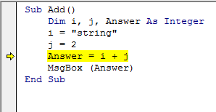
Debugging
What would you do when you run your macro and encounter an error like this?
You can press the button “End” to stop the macro
Or you can press “Debug”, the macro will stop at the line where the error occurs
Then what to do?
Eyeballing line by line and hope to find some clue?
Comparing your codes with your classmates whose macro runs successfully?
Use many Msgbox to show the value of your variables?
…..

Slide 4
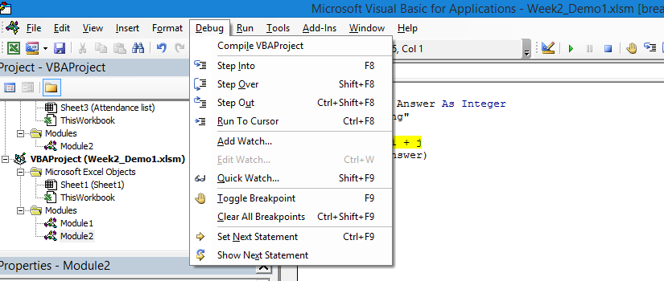
Debug Menu
A list of commands are very useful for debugging
“Step Into” and “Toggle Breakpoint” are the most frequently used ones

Slide 5
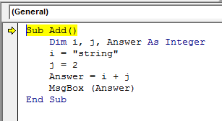
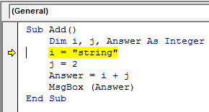
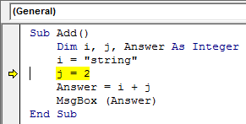
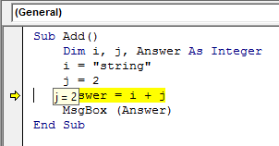
Step Into
Instead of “Run” the entire macro script at one time, you can choose to run it line by line by using “Step Into”, or
short-cut key “F8”
Use the simple example below, press F8. (Note: please put your cursor inside your script)
“Step Over” and “Step Out” are used when you call another function in your script. Try them yourself.
Press F8 again, Stop at the 3rd line. The 2nd line is skipped as it is defining variables only
Press F8, Stop at the 1st line
Hop over the variable to check whether the value is obtained as expected

Slide 6
Exercise
Copy the following codes to your VBA code editor
Sub Add_StepInto()
Dim i, j, Answer As Integer
i = "String"
j = 2
Answer = i + j
MsgBox Answer
End Sub
Press F8 to run the codes line by line
How to fix the error?
Change “String” to a number, e.g 3, the answer will be 5

Slide 7
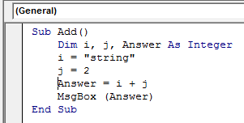
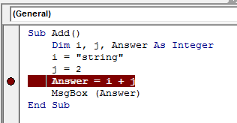
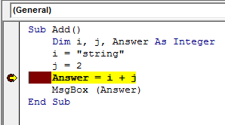
Toggle Breakpoint
If your script is quite long and you don’t want to waste your time to run step by step, you can set “Breakpoint” in your script and let the macro run up to the breakpoint you set.
Put your curser in the line where you want the macro to stop, then press “Toggle Breakpoint”, or short-cut key F9
Press “Run”, or F5 to run the macro, then the script will run to the breakpoint you set just now.
Then you can take a closer look at your current values of variables or check the current output in your Excel sheet.
Press F9 again to cancel the breakpoint when you feel it is no longer required

Slide 8
Exercise
Use the previous codes you have copied
Sub Add_StepInto()
Dim i, j, Answer As Integer
i = "String"
j = 2
Answer = i + j
MsgBox Answer
End Sub
Set your breakpoint at the line “ Answer = i + j ”
Run the codes
Resume the codes

Slide 9
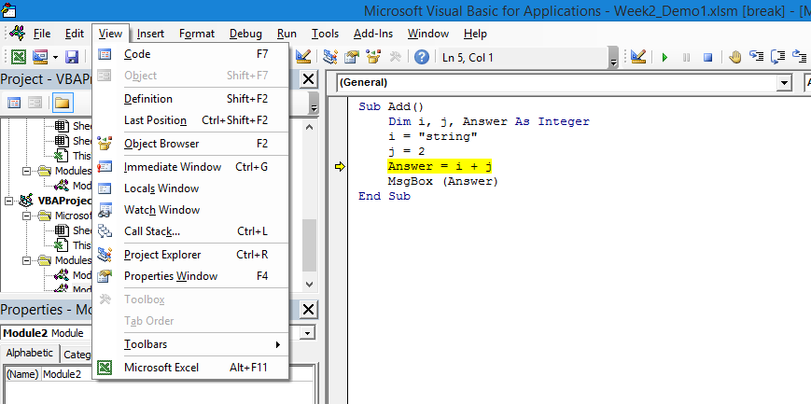
Immediate Window
Take the example above
If your macro runs and stops at the line highlighted, you want to know whether the line will become correct if you change the value of variable i or j
Follow the menu, or press Ctrl+G to open “Immediate Window”

Slide 10
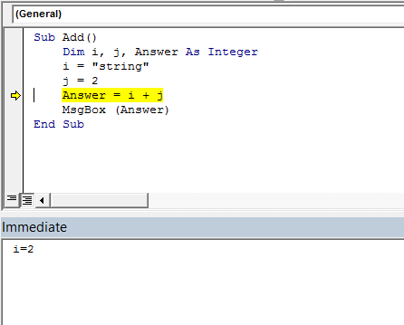
Immediate Window
Type i=“number” in the immediate window and press “enter”
Run the macro again and see whether the error will disappear
The error still remains
Then, try i=2, press “enter”, run again
The error is gone
Watch Window and Local Window are more advanced tools to help you understand the problems occurred. Find out yourself if interested.

Slide 11
Exercise
Use the previous codes you have copied
Sub Add_StepInto()
Dim i, j, Answer As Integer
i = "String"
j = 2
Answer = i + j
MsgBox Answer
End Sub
Open your immediate window if it doesn’t exist
Try different values for variable i to see whether the error is gone

Slide 12
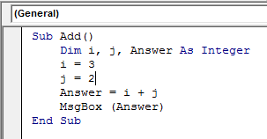
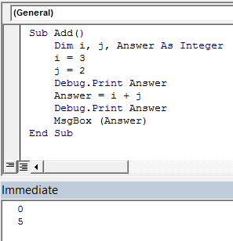
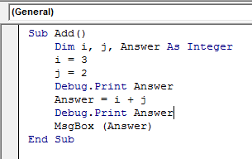
Debug.Print
If you don’t want to stop your macro but still want to know the changes of certain variables, or want to know the value of the variables at certain time, you can use “Debug.print” to know the values via immediate window.
Or, very often, your macro runs smoothly without any errors, but your final results are wrong, you have no idea where to put breakpoints. Then you can use Debug.print also.
Debug.print is just like MsgBox, but it doesn’t stop the macro
Take an example,
I want to know the changes of values for variable “Answer”
Then write my codes as highlighted, then run the macro
After the macro finishes running, the value will be shown in the immediate window

Slide 13
Exercise
Use the previous codes you have copied but change to i =3
Sub Add_StepInto()
Dim i, j, Answer As Integer
i = 3
j = 2
Answer = i + j
MsgBox Answer
End Sub
Add Debug. Print in your codes to see the value of answer at different places through immediate window
You can remove the line “MsgBox Answer” if you use Debug.Print

Slide 14
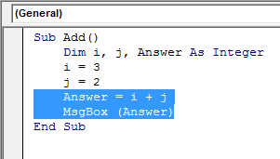
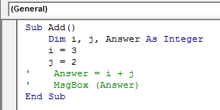
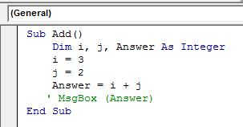
Comment Block
Basically, lines commented in the script will not be executed
Comments are widely used in the script to explain what a line or a segment of lines are doing
Another usage is to skip the lines which you think may have issues.
How to comment
Add a single quote at the beginning of the line
The line will turn green
The “MsgBox” will not run
For multiple lines, select multiple lines
Open this toolbar
Press, to to block multiple lines as comments
Press, to unblock the comment

Slide 15
Exercise
Use the previous codes you have copied
Sub Add_StepInto()
Dim i, j, Answer As Integer
i = "String"
j = 2
Answer = i + j
MsgBox Answer
End Sub
Comment the line
i=“String”
MsgBox Answer
Run the codes

